Slide 1

Lets get on to a bus!
Anantheswar G

Slide 2
Index
Hello Message-oriented-middleware! (MOM)
Messaging Paradigms
Key Terminology
Hello Enterprise Service Bus! (ESB)
Hello Rabbit MQ!
What is Mass Transit? (MT)
How do I get started?
Demo
References

Slide 3
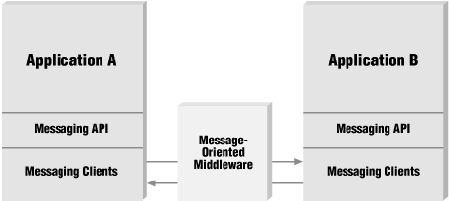
Hello Message Oriented Middleware!
Infrastructure supporting sending and receiving messages between distributed systems
Why MOM?
asynchronous message-passing, as opposed to a request-response architecture
Routing
Transformation
Distributed heterogeneous platforms
minimized coupling
Fault tolerance
data freshness
Defined Data Format

Slide 4

Messaging paradigms
Point-to-point
Fan-out
Publish/ Subscribe
Request-response

Slide 5
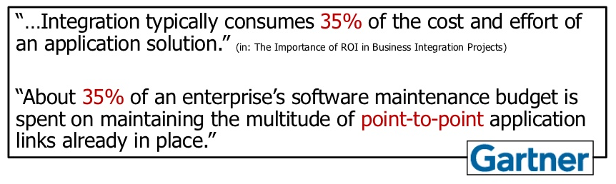
Key Terminology: Enterprise Application Integration
The process of linking applications within a single organization together in order to simplify and automate business processes
File Transfers
Shared Databases
Web Services

Slide 6
Message Broker
An intermediary program module which translates a message from the formal messaging protocol of the sender to the formal messaging protocol of the receiver
Receive messages from multiple sources
Determine the correct destination
Maintain and Manage queues
Abstract out developer effort for handling low level calls
Improved Security, Testability and modifiability
Increased Complexity, maintenance effort. Reduced Availability and Performance

Slide 7
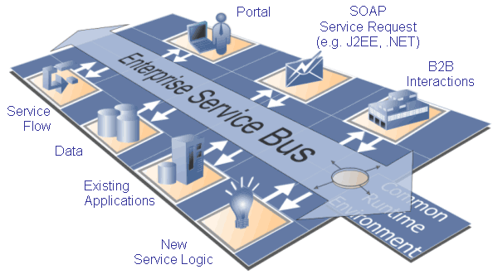
Hello Enterprise Service Bus! (ESB)
Enterprise service Bus refers to a Software architectural style
Abstraction on top of an existing messaging system
Removes the coupling between the Called Service and the Transport

Slide 8
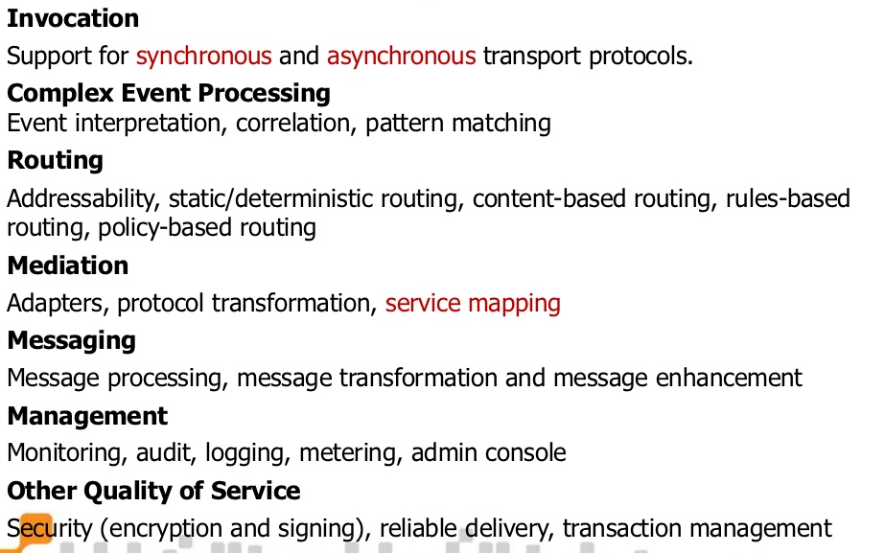
Why ESB?

Slide 9
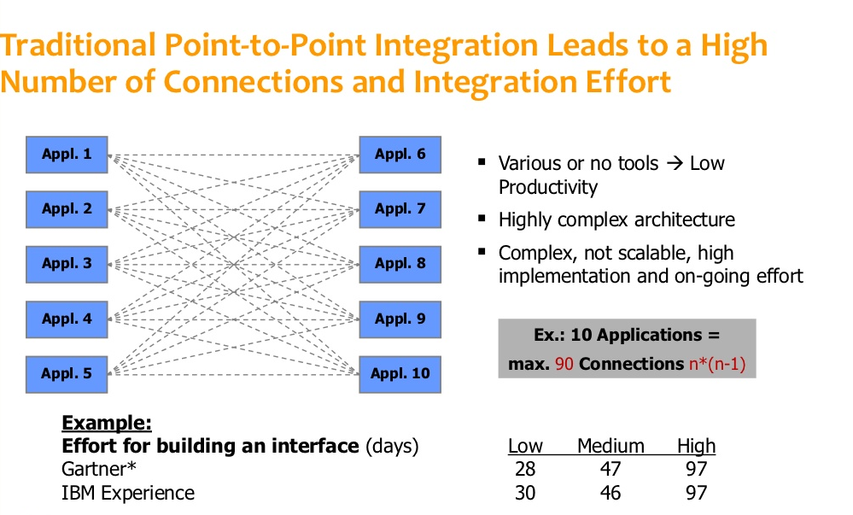
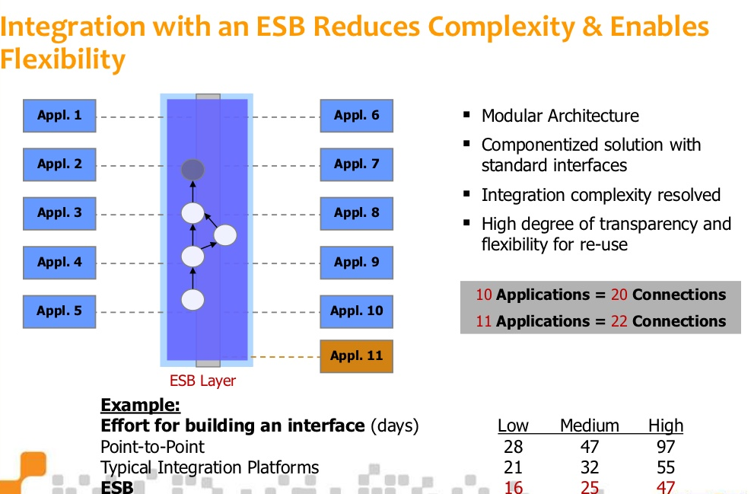
ESB and without

Slide 10

Hello Rabbit MQ!
An intermediary program module which translates a message from the formal messaging protocol of the sender to the formal messaging protocol of the receiver
Reliability
Flexible Routing
Clustering
Highly Available Queues
Multi-protocol – STOMP, AMQP, MQTT
Clients supporting multiple languages
Management UI
Tracing

Slide 11

Hello Mass Transit!
.NET based ESB
Light weight Service Bus Implementation
Open Source
Supports MSMQ, ActiveMQ, RabbitMQ, TIBCO, EMS
Supports Message Orchestration via Automatonymous
Log4net and IOC container integration
Error Handling, Fault Tolerance

Slide 12
How Do I get Started?
Install ErLang
SET ERLANG_HOME as an environment variables
Install Rabbit MQ
Check the RabbitMQ service is running
Install Rabbit MQ and Mass Transit Nuget packages into your solution

Slide 13
Demo
How to Create a publisher
How to Create a Consumer
How to Create a Services Bus
How to integrate structure map with service bus
Serialization options with service bus
How to use log4net with mass transit
Error handling with mass transit

Slide 14
References
http://en.wikipedia.org/wiki/Message-oriented_middleware
http://masstransit.readthedocs.org/en/latest/index.html
http://www.slideshare.net/PhatBoyG/event-driven-architecture
http://www.drowningintechnicaldebt.com/ShawnWeisfeld/archive/2010/02/04/event-driven-architecture-by-chris-patterson-north-dallas-.net.aspx
http://www.slideshare.net/bahaafarouk/esb-overview
https://www.rabbitmq.com/install-windows-manual.html

Slide 15
Thank You

